Slide 1
Source Water Protection and Development - Conflicts and Convergence
2015 New England Water Works Association Symposium
Devens, Massachusetts
October 22, 2015

Slide 2
Truslow Resource Consulting LLC
:: 454 Court Street :: Suite 304 :: Portsmouth, NH 03801 :: (603) 766-6670 :: www.truslowrc.com
Danna Truslow, PG, CG – Principal Hydrologist
Samantha Wright – Geomorphologist and GIS Specialist
Anna Boudreau – Land Conservation Consultant, Training and Outreach

Slide 3
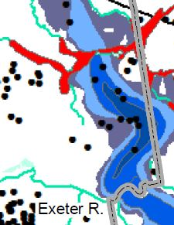
..or The Evolving Role of Local Planning and Land Conservation in Protecting Aquifers for Future Community Water Supplies
Notes:
Protect the resource
Without preventing future community water supply

Slide 4
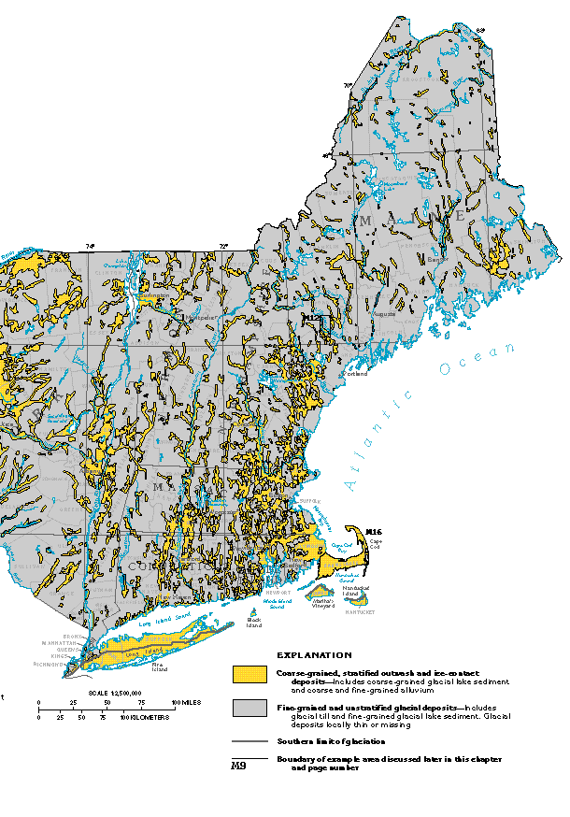
Significant but Limited Sand and Gravel Deposits
From USGS HA-730-M
Notes:
Stratified drift and ice contact
Focus on small area in red box – SE New Hampshire

Slide 5
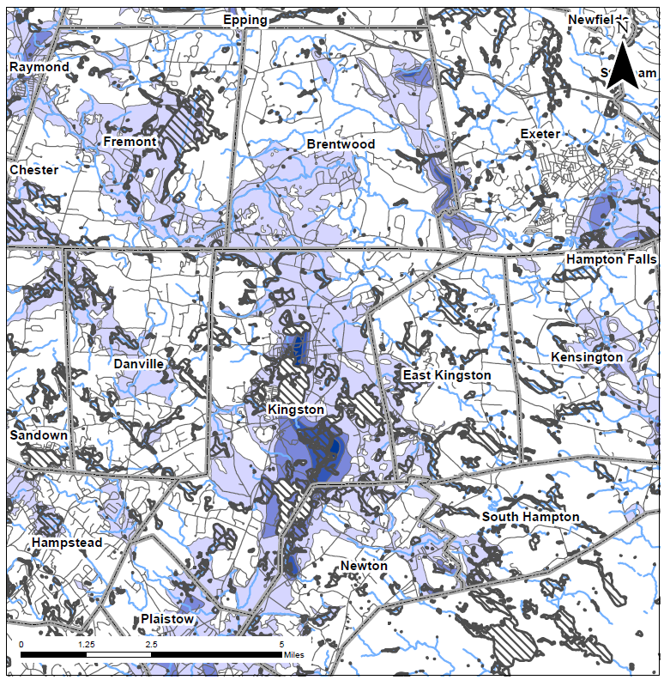
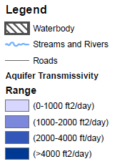
Focus Area Brentwood and Kingston, NH

Slide 6
Conflicts
Past/existing land use in high value aquifer areas
Local control of water resources - commercialization
New board /commission members
Land use restrictions in future water supply areas
Encourage commercial development
Increased infiltration in aquifer/water resource areas – water quality impacts – road salt, landscaping chemicals, other emerging contaminants?

Slide 7
NH – 1982 Early Aquifer Protection Planning Document Overlay districts – 1990’s
Notes:
Completed through an internship with SENH Planning Commission and NH Water Resource Research Center – 5 USGS publications that defined the sand and gravel resource
All you need to know about groundwater and how to protect it

Slide 8
Brentwood, NH
Aquifer Protection Overlay District – 1992
Active Land Protection Efforts – Conservation Commission and Regional Land Trust
Agricultural – semirural transition
Private Bottling Company – reaction
Balancing growth and protection
2015 NR Ordinance update and LP/WSR Inventory

Slide 9
NHDES Registered Wells in Brentwood
Wells registered since 1984
Well Water Source | Number of Wells | % of total wells
Sand and Gravel | 34 | 8%
Bedrock | 385 | 92%
Total | 419
Summary of public water supply characteristics
Groundwater Source | # of active systems | # Active in Aquifer Zone | # of active community wells | # of active Transient, non-community | # of active Non-Transient, non-community
Sand and Gravel | 3 | 2 | 2 | 1 | 0
Bedrock | 15 | 8 | 2 | 5 | 8
Total | 18 | 10 | 4 | 6 | 8

Slide 10
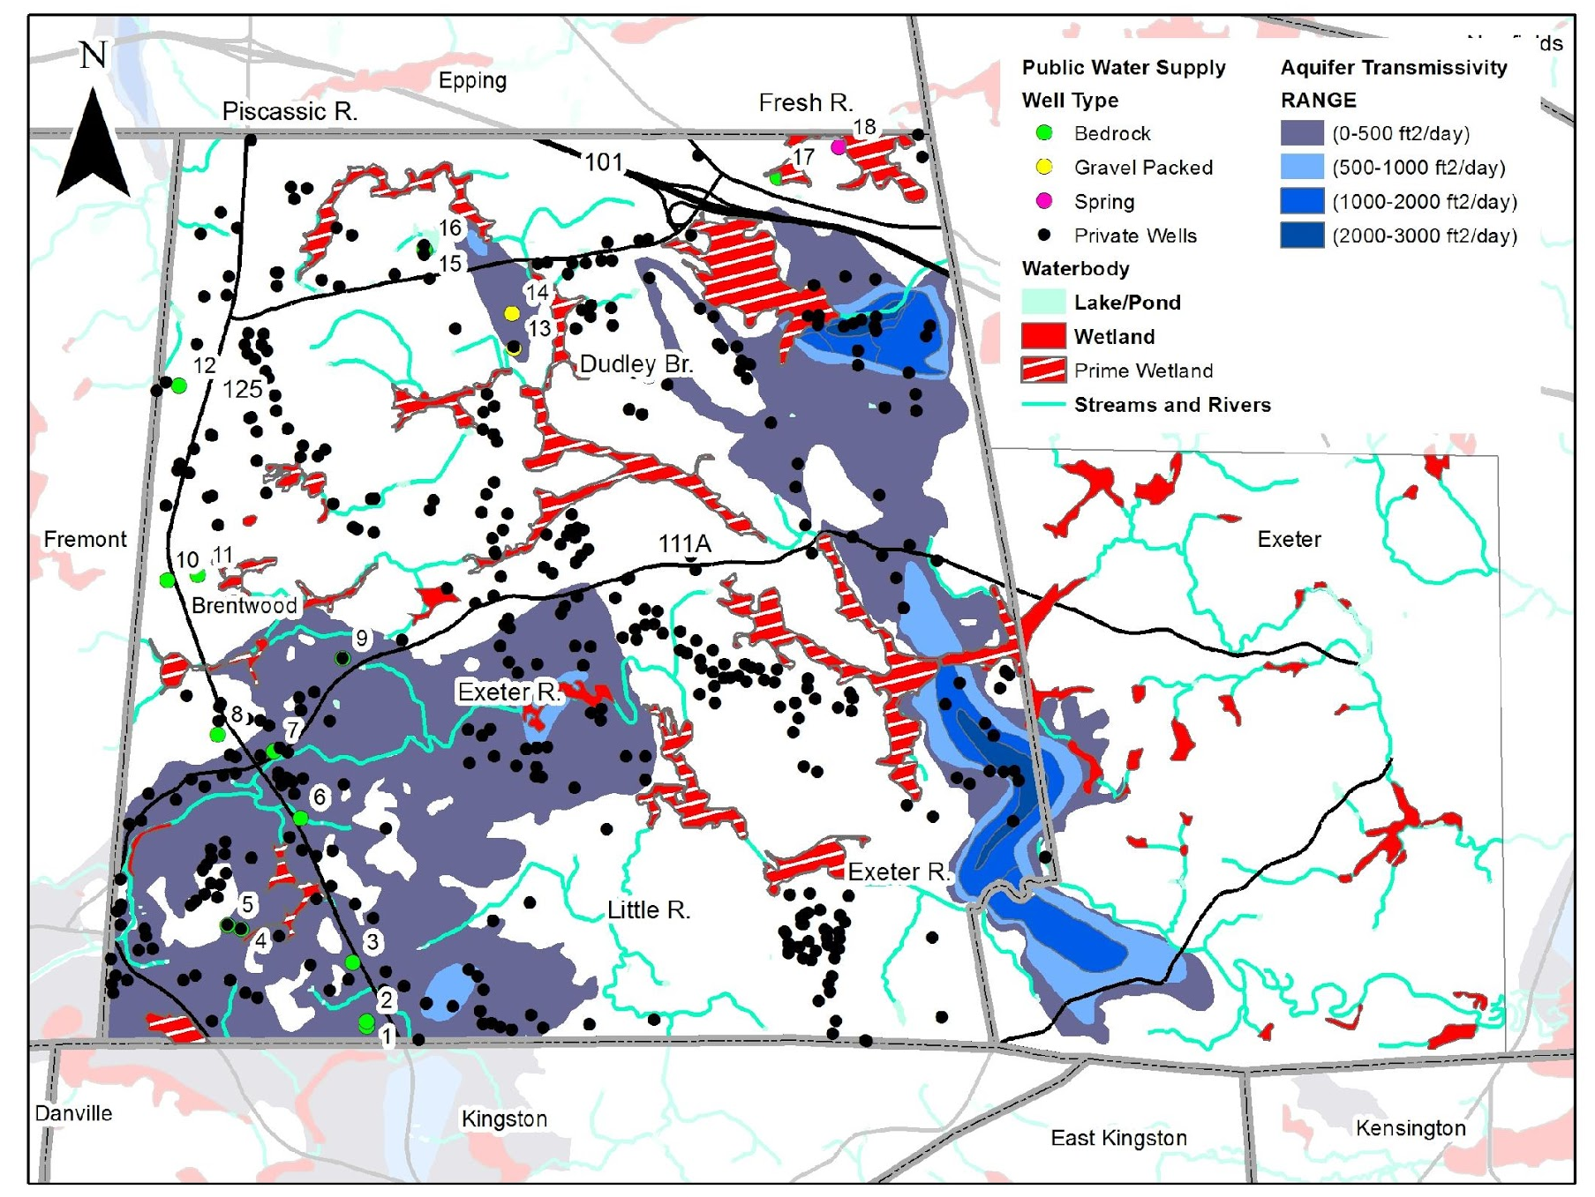
Co-Occurrence of Resources
Notes:
Reduce area around town, label ponds, major rivers

Slide 11
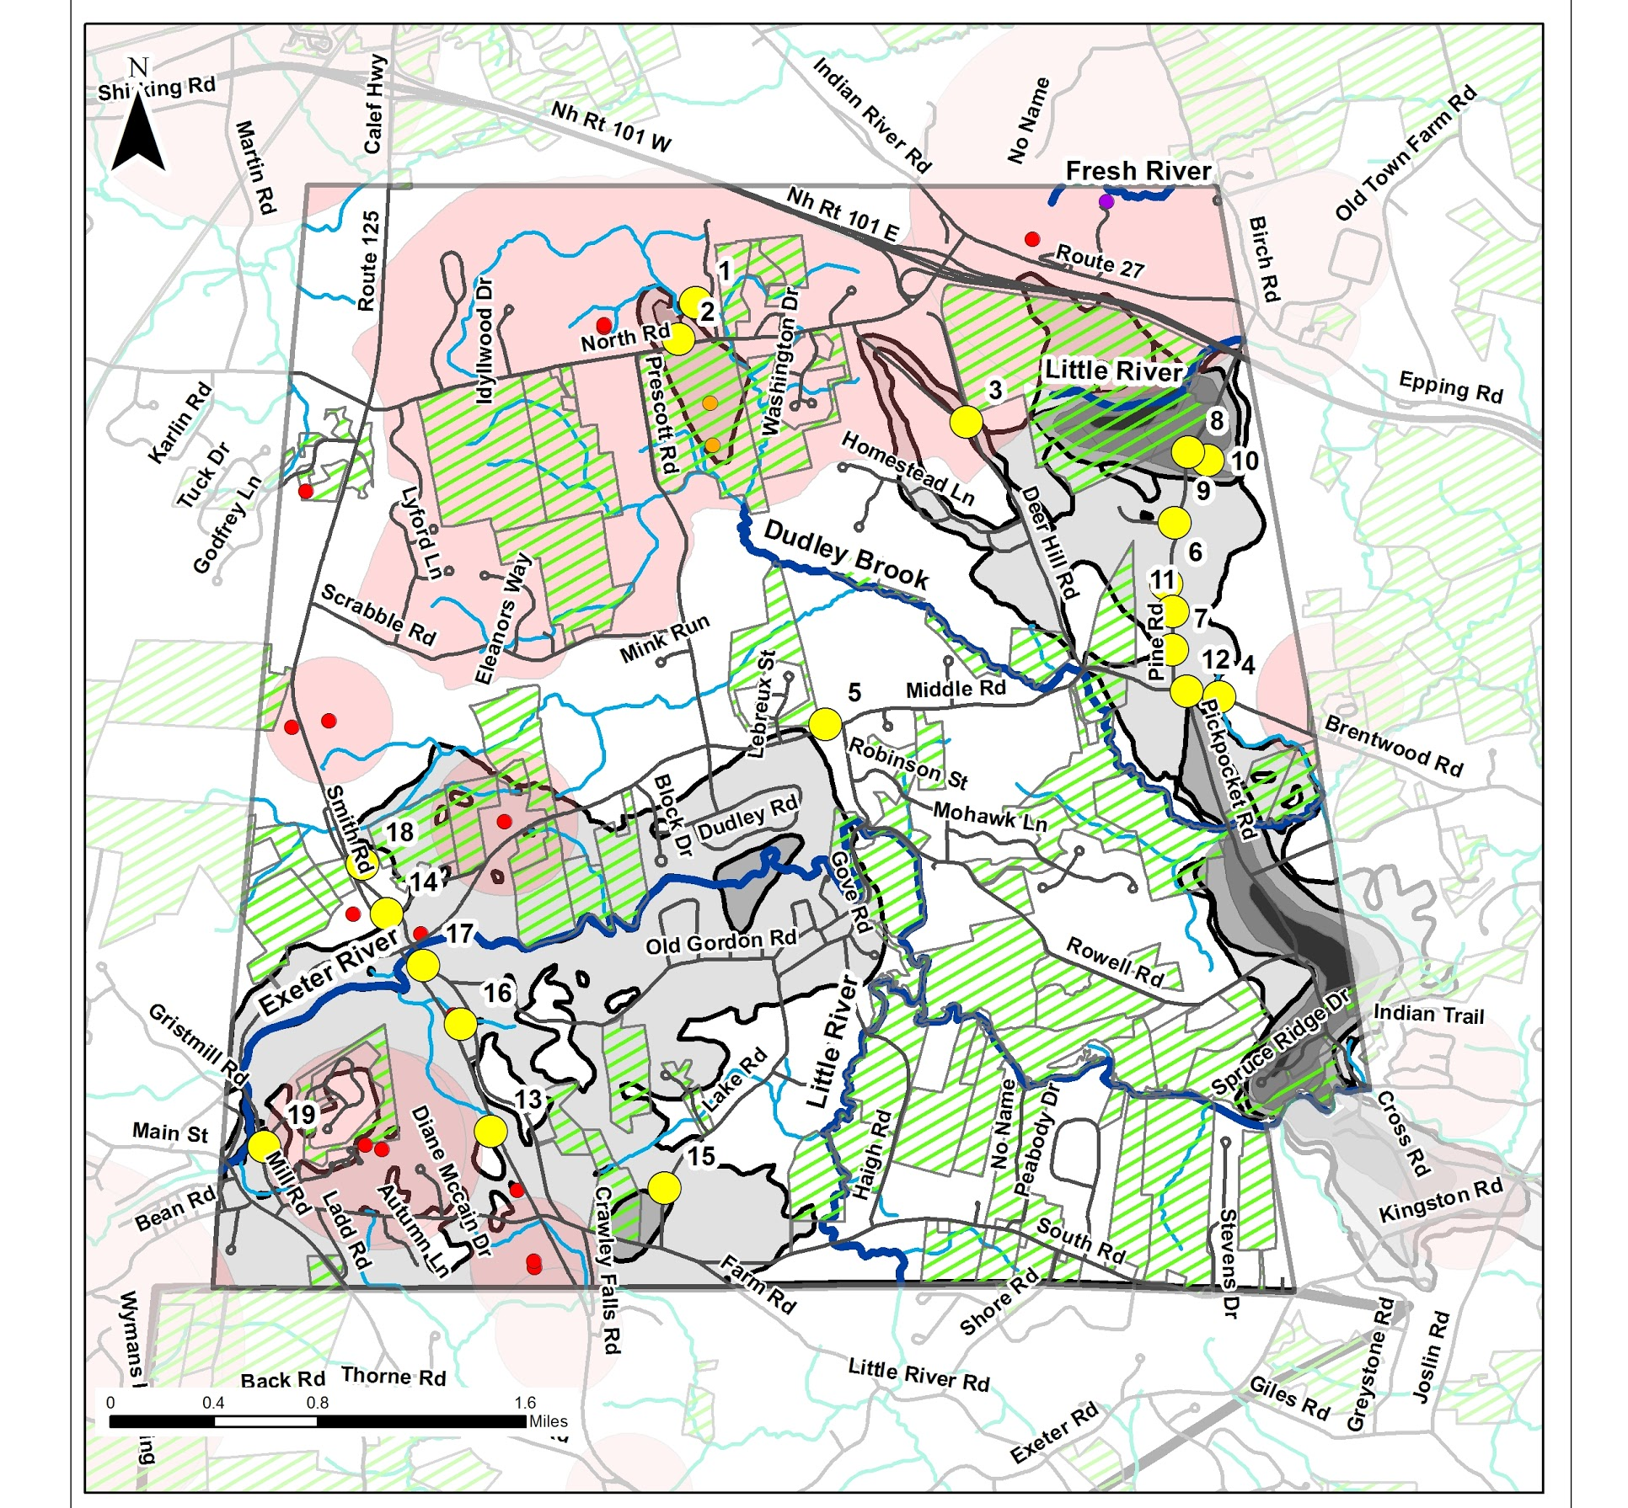
Notes:
Point out Pine Road and Route 125
Sand and gravel extraction
Industrial/commercial activity

Slide 12
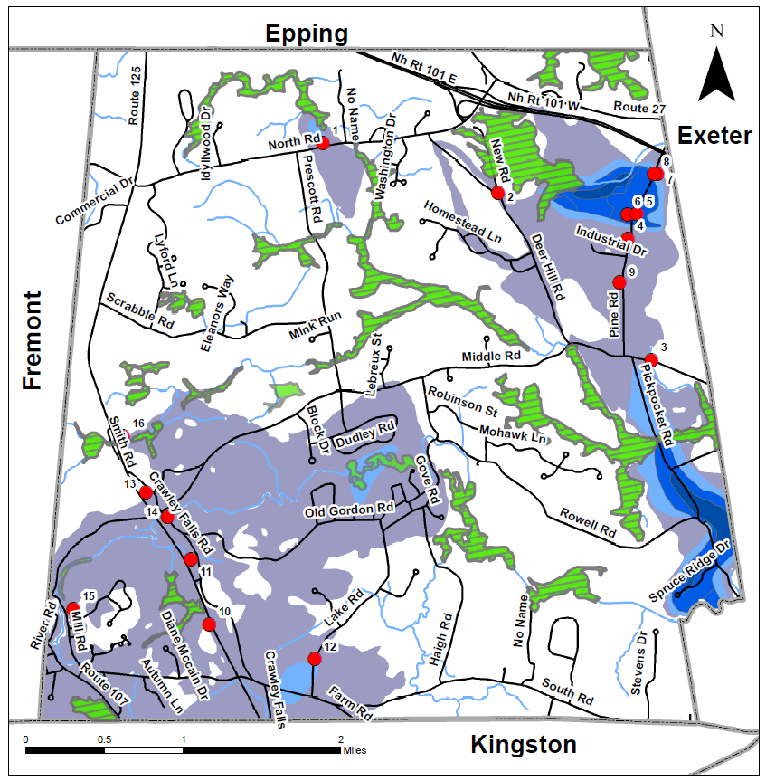
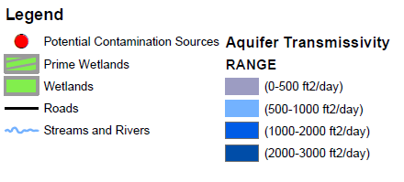
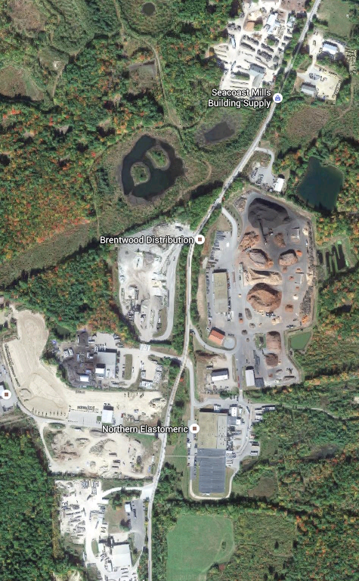

Slide 13
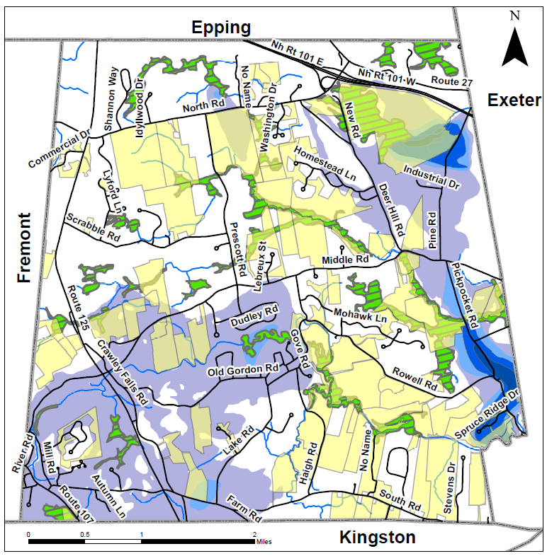
Conserved Lands in Brentwood
By the Numbers:
~3,279 acres of conserved land
~30% of Brentwood land is conserved

Slide 14
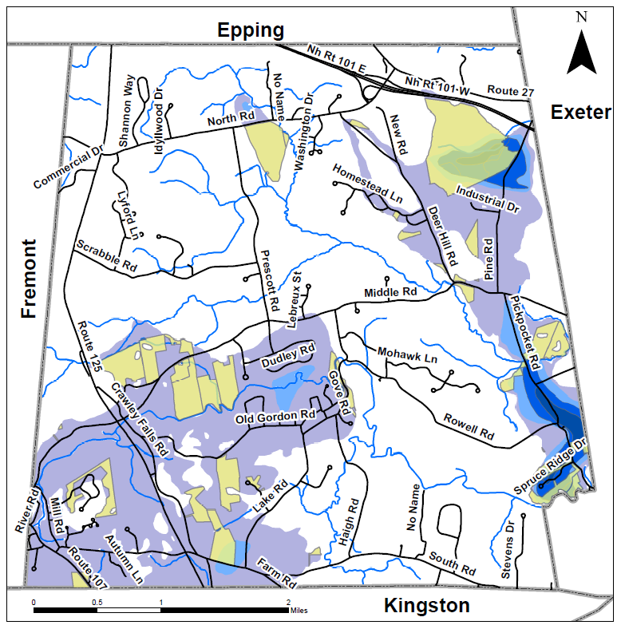
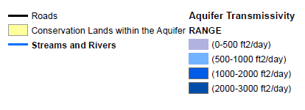
Conserved Lands within Aquifer
~ 756 acres of aquifer are conserved land
~20% of aquifer is conserved

Slide 15
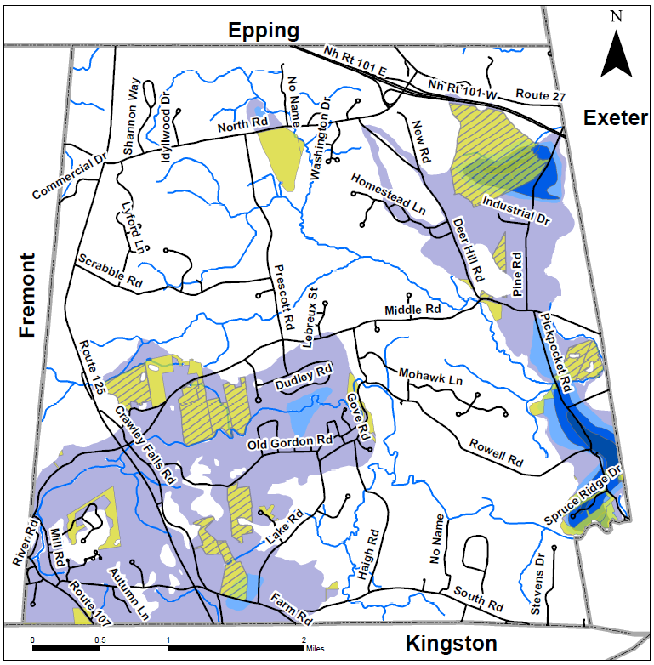
Water Supply Development Restrictions on Conserved Land
~ 530 acres of conserved land in aquifer has water supply use restrictions
~70% of currently conserved land has water supply use restrictions
~14% of aquifer has water restrictions written into a conservation easement

Slide 16
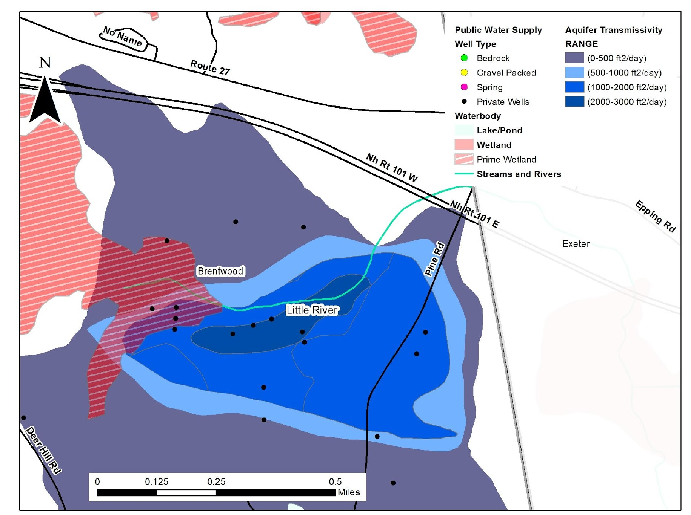
Close-up – Groundwater, Surface Water and Wetland Resources in NE Brentwood

Slide 17
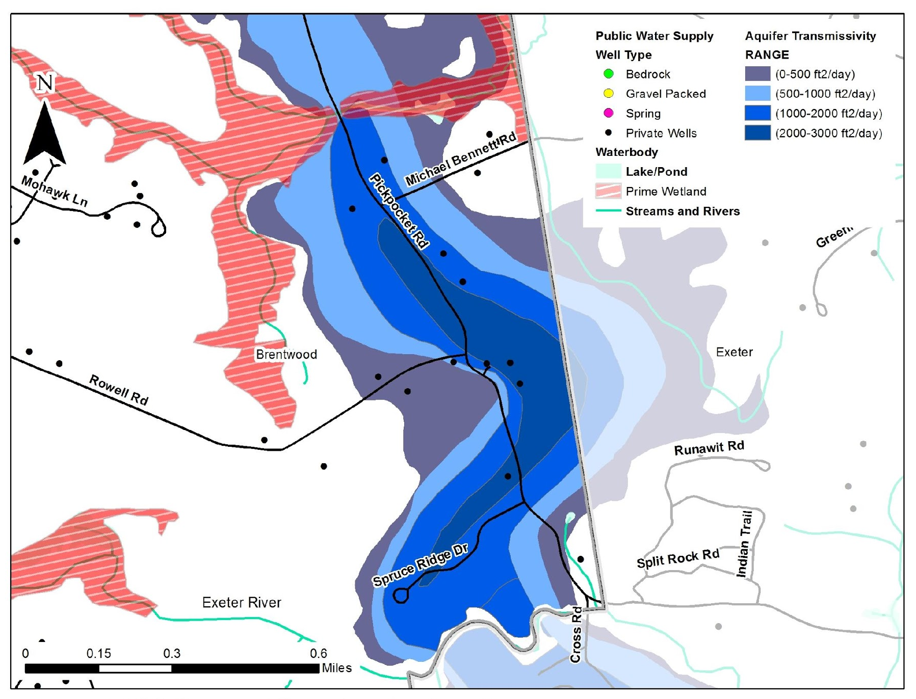
Close-up – Groundwater, Surface Water and Wetland Resources in SE Brentwood
Note: Wetlands are not shown for Exeter

Slide 18
Ordinance Update
Water Resource 101
Better definition of resource
Co-occurrence of resources
Impact of new local stormwater regulations on resource
Improve consistency and ease of use
Provide outside resources/references
Prioritize land conservation and water supply restrictions in aquifer district

Slide 20
Kingston, NH
Aquifer Protection Overlay District – 1990
Active Land Protection Efforts – Conservation Commission and Regional Land Trust
Agricultural – semirural transition
Groundwater monitoring at permitted developments?
2011 Aquifer Protection Ordinance update
Industrial/commercial along Rt 125 – allow additional growth?

Slide 21
Registered Wells in Kingston

Slide 22
Baseline data to understand existing water quality
1079 wells registered since 1984
23% in stratified drift aquifer
31 Active Public water supplies
152 Potential Contaminant Sources in Kingston – 70% in aquifer
Notes:
Circles with number are registered public water supply wells
Red dots are PCS’s, multiple sources on several sites
Large circles are community water supply wells

Slide 23
Proposed Aquifer Protection District
Boundaries A and B
Zone B
Protects Most Vulnerable Resource Area
Provides Land Use Flexibility
Zone A
Zone A
Zone B

Slide 24
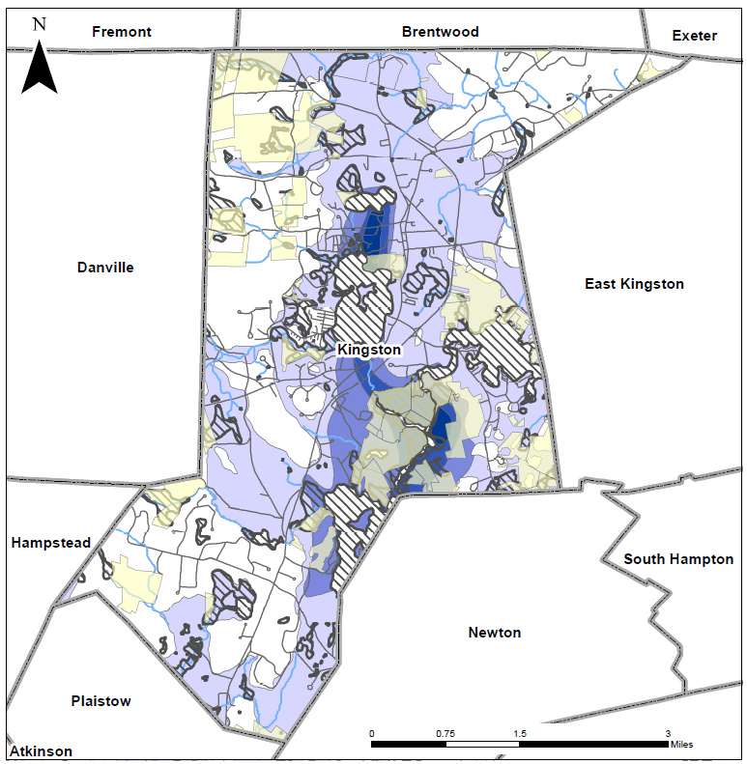
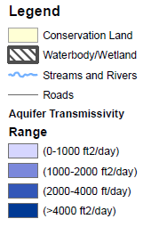
Conservation Lands
What are Water Supply Restrictions?

Slide 25
Kingston – to do
Revisit overlay district – new development?
Future Water District?
Evaluate water supply land use restrictions
Refocus land protection efforts?
Groundwater monitoring at permitted developments – what real water quality impacts?

Slide 26
Regional Efforts Southeast Watershed Alliance Piscataqua Region Estuaries Partnership Ordinance Review and Priorities
NOT in SCOPE
PREPA 2015

Slide 27
Convergence - Municipal Awareness and Action
Historic use of lands
Current resource and threats
Current and future /land/water resource needs and goals – Master Plan
Board/Commission engagement, training and coordination
Economics – Attention now can save municipality in long run
Track – control emerging impacts through BMPs
Revisit and Refocus Regularly
Notes:
Protect the resource
Without preventing future community water supply

Slide 28
Questions?

